Slide 1
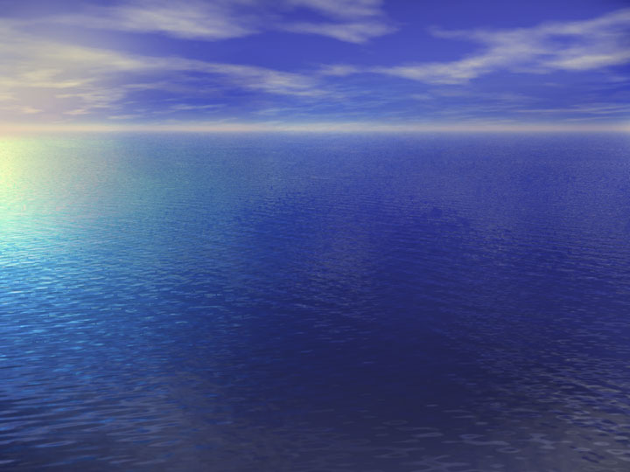
Animal survival
Water and waste

Slide 2
Aims of today…
To be able to:
Identify ways in which a mammal gains and loses water.
State that the kidneys are the main organs for regulating the water content in a mammal.
Explain the role of ADH in the regulation of water balance.

Slide 3
70 % of our bodies are water!

Slide 4
We gain liquid from….
Milk
Tea
Coffee
7up
Water itself!
Food?!
Chemical reactions…
Food | % water
Lettuce | 95
Potato | 78
Cheese | 40
Bread | 35
Cornflakes | 5

Slide 5
Chemical reactions
Aerobic respiration
Glucose + oxygen → Water + Carbon + energy dioxide

Slide 6
We lose water through…
Sweat
Breath
Urine (kidneys)
Faeces (easily expelled)

Slide 7
Water balance
70% of our bodies are water.
Stays constant due to our kidneys…
Drinking lots of water =
lots of pee!
Drinking little water =
Little pee!

Slide 8
ADH
Kidneys are controlled by anti-diuretic hormone (ADH) released from the pituitary gland (attached to brain).
ADH (a hormone) controls volume of water reabsorbed and returned to bloodstream by kidneys.
Water not reabsorbed passes to bladder as urine to be expelled.

Slide 9
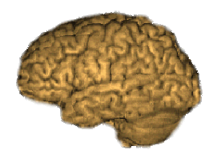
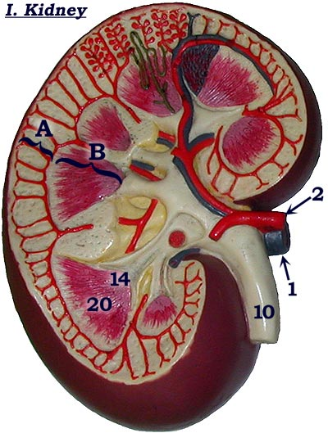
Water content of
the blood LOW
Water content of the blood HIGH
Too much water drunk
Too much salt
or sweating
Brain produces
More ADH
Brain produces
Less ADH
Water content
of the blood normal
High volume of water
reabsorbed by kidney
Low volume of water
reabsorbed by kidney
Urine output
LOW
Urine output
HIGH
(small volume of
Concentrated urine)
(large volume of
dilute urine)

Slide 10
This powerpoint was kindly donated to www.worldofteaching.com
http://www.worldofteaching.com is home to over a thousand powerpoints submitted by teachers. This is a completely free site and requires no registration. Please visit and I hope it will help in your teaching.

